Slide 1

Welcome

Slide 2
Recommender System

Slide 3
Recommender System
Recommendation systems, or recommender systems, are software engines designed to suggest items to users depending on previous likes, dislikes, interests, product engagement and interaction, etc.
Recommender systems keep users interested in the site.

Slide 4
We are surrounded with Recommender systems:

Slide 5
Why Recommender Systems :
1. To Increase Sales
2. To decrease load on the system
3. Increasing engagement and Satisfaction

Slide 6
Types of Recommender Systems :
1. Popularity Based Recommender System
2. Content Based Recommendation System
3. Collaborative filtering system
4. Hybrid Recommendation System

Slide 7
Popularity Based Recommender Systems :
Popularity Based Recommender System : Using the avg rating a book got from a user we will find the best book rank and using that rank we will suggest that list of books to all universally.

Slide 8
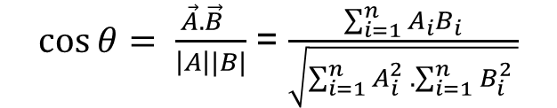
Collaborative filtering system :
Collaborative filtering system : Based on the ratings given by different user we will try to find similar books and recommend them based on the choice they make
We are using cosine similarity algorithm to find similarity between books.
$\cos{θ= \frac{\vec{A}.\vec{B} }{\left|A\right||B|}}$ = $\frac{\sum_{i=1}^{n}{A_{i}B_{i}}}{\sqrt{\sum_{i=1}^{n}{A_{i}^{2} }.\sum_{i=1}^{n}{B_{i}^{2} }}}$

Slide 9
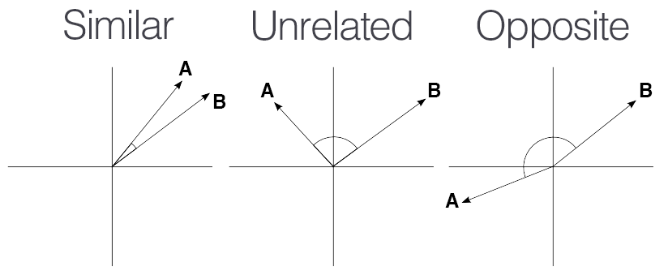
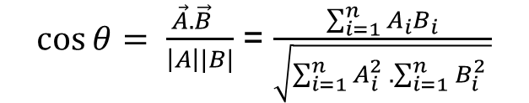
For each book different user ratings are written as a vector and similarity between each books user vector is calculated using cosine similarity which is the cos value between each vector.
$\cos{θ= \frac{\vec{A}.\vec{B} }{\left|A\right||B|}}$ = $\frac{\sum_{i=1}^{n}{A_{i}B_{i}}}{\sqrt{\sum_{i=1}^{n}{A_{i}^{2} }.\sum_{i=1}^{n}{B_{i}^{2} }}}$

Slide 10
$\cos{θ= \frac{\vec{A}.\vec{B} }{\left|A\right||B|}}$ = $\frac{\sum_{i=1}^{n}{A_{i}B_{i}}}{\sqrt{\sum_{i=1}^{n}{A_{i}^{2} }.\sum_{i=1}^{n}{B_{i}^{2} }}}$

Slide 12
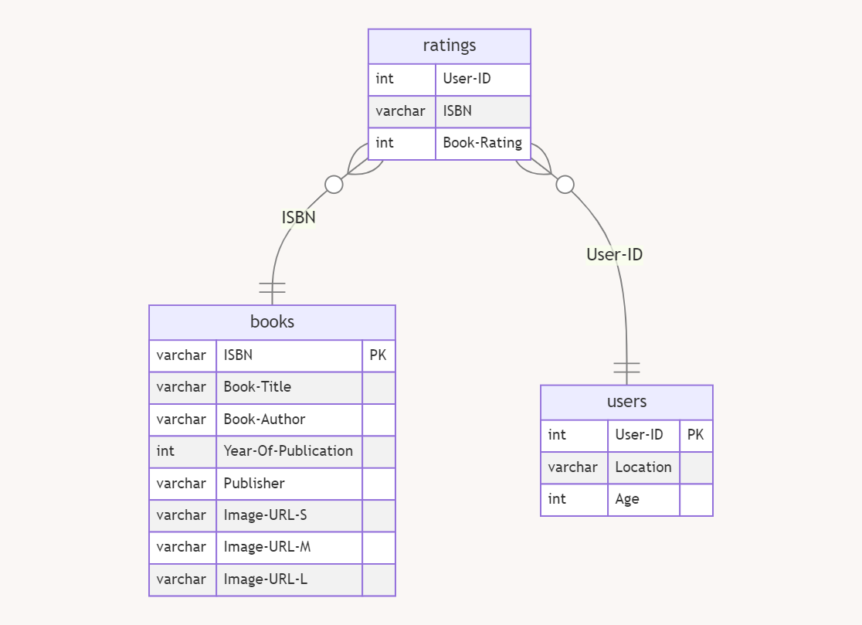
Data
3 Files

Slide 13
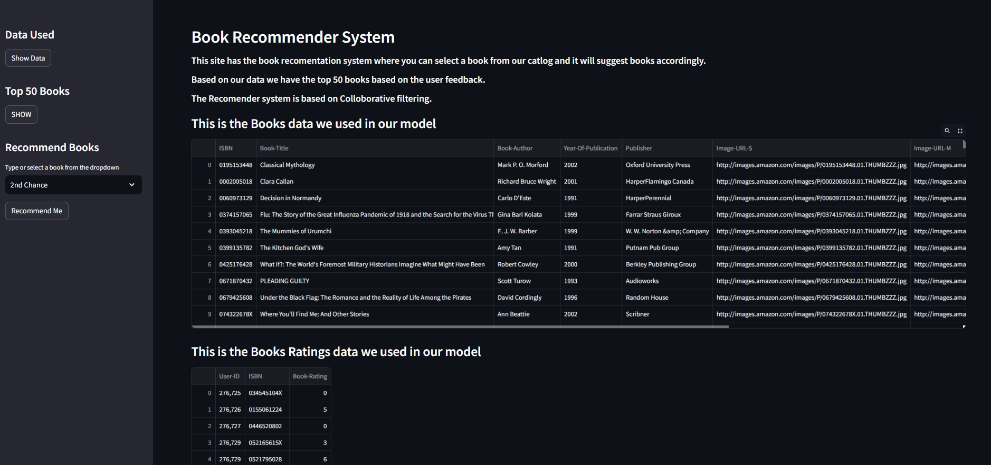
Data Used Section

Slide 14
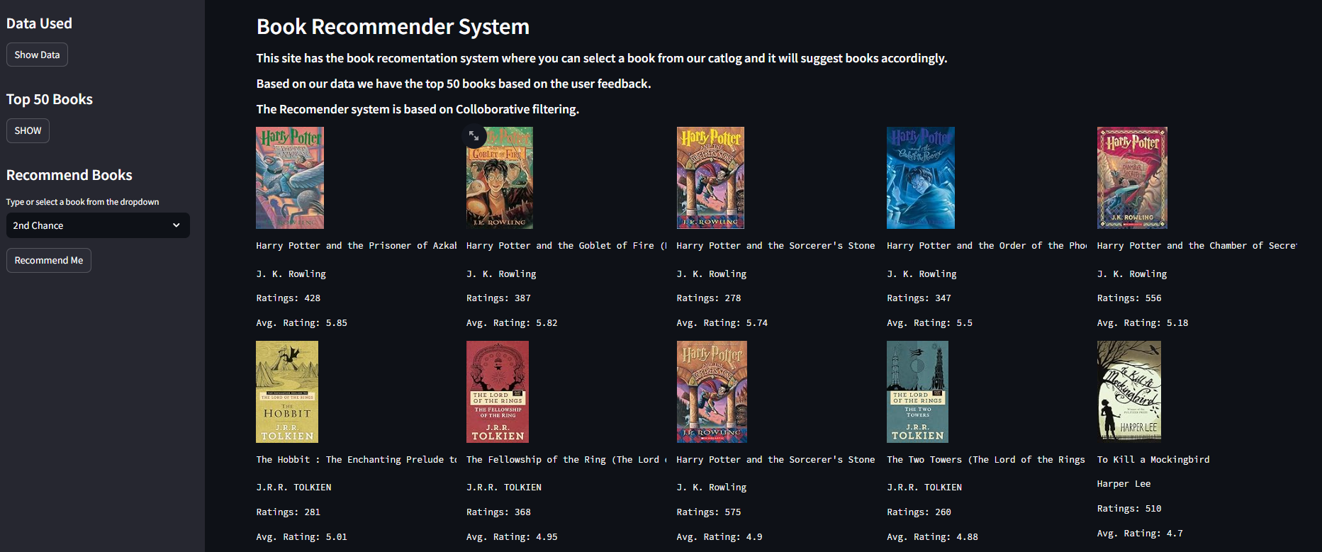
Top 50 Recommendation

Slide 15
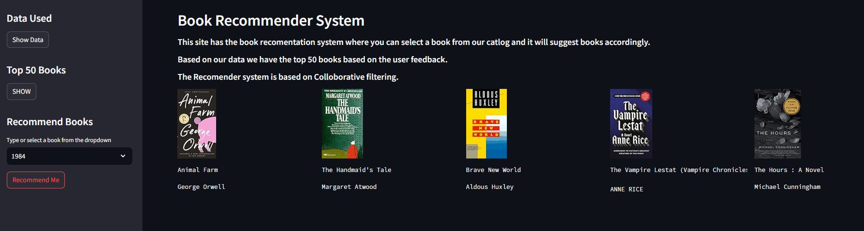
5 Similar Book Recommendation

Slide 16
ALL THE BEST

